Slide 1
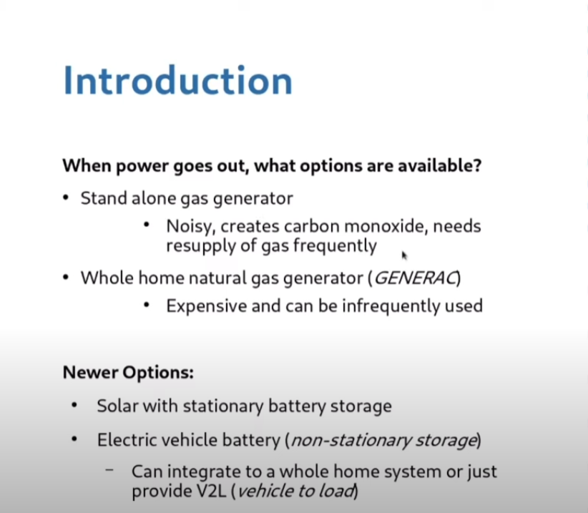
Steve Miller, Guest Speaker
Source:
www.youtube.com
QYRgfLgKOW8
“Electric Vehicles as
Home Backup Power”
Oct, 2024
Hosted by Walter on
“The Network
Architect Channel”
Notes:
….\2025-1-16\EV AS HOME STORAGE.pptx
READ THE SLIDE.
There are many bloggers, and youtube recordings on the “NEWER OPTIONS” many are referenced on slides and on last page “RESOURCES”
USING the EV to supply backup to power the house during grid failure has car manufacturers jumping for joy at the market potential for their own EV brand:
There are current standards being drafted on interconnecting mobile batteries (non-stationary storage) to both buildings, and into the grid.
Many (probably most) auto manufacturing are looking at this as a profitable opportunity , and testing the market.
We will hold questions to my ending slide

Slide 2
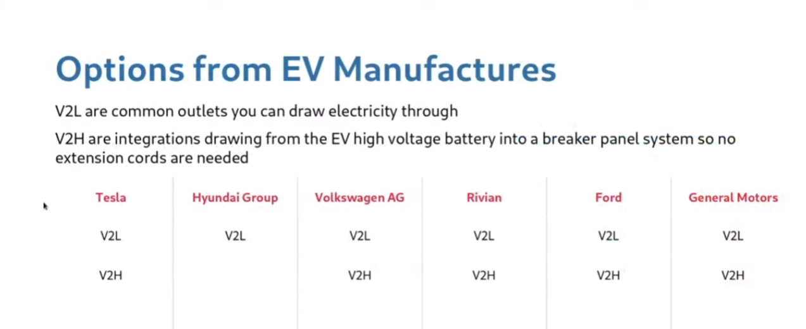
ALL 2026 EV BRANDS (7)
PROPRIETARY DATA
TO BI-DIRECTIONAL CHARGER
PROPRIETARY DATA
TO BI-DIRECTIONAL CHARGER
PROPRIETARY DATA
TO BI-DIRECTIONAL CHARGER
V2H
Ionique 5
Ionique 6
Silverado EV RST/WT
Blazer EV
Equinox EV
Cadillac LYRIQ
V2L Adders: Nissan Leaf (since intro?); Toyota Prius Prime (only at 2017 intro?)
Source: www.youtube.com QYRgfLgKOW8 “Electric Vehicles as Home Backup Power” Oct, 2024
Hosted by Walter on “The Network Architect Channel”
Notes:
V2L : is the initial use of mobile storage: When you need power, just plug your extension cords into 120 volt outlets on the car or pickup and power what you wish. The Ford Lightning is featured as the Workhorse of choice for contractors, who can simply plug-in to truck and freely use their outdoor tools remotely, wherever the truck is located.
V2H: Plug your EV into a bi-directional charger, mounted on your house. Normally that charger delivers house electricity to charge the EV. The bi-direction charger reverses this: the EV now can deliver electricity to power the house, during power outages.
This lists 6 EV manufacturers, and two other (“adders”).
GM has 7 brands of EVs. The 2026 models of all 7 brands have identical proprietary signalling between car and house
The proprietary interface means that when you buy one auto manufacture’s car, you will then buy an expensive bi-directional charger to handle the V2H (vehicle to house), from from that same ONE car manufactuer. You become LOCKED INTO models from that car manufacturer- when you replace your car, you must replace with the SAME car manufacturer, for the life of that expensive EV charger on the wall (and maybe the life of all theother equipment required to power your house from your EV)
I will show more detail in next several slides

Slide 3
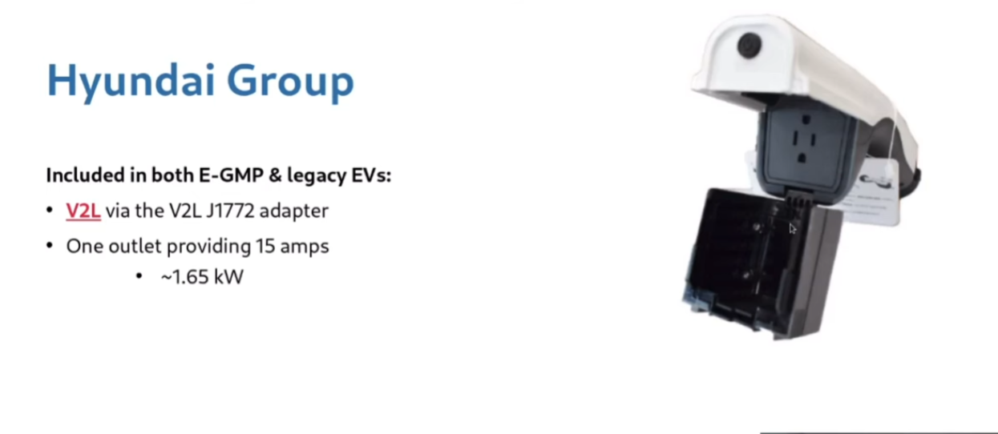
Source: www.youtube.com QYRgfLgKOW8 “Electric Vehicles as Home Backup Power” Oct, 2024
Hosted by Walter on “The Network Architect Channel”

Slide 4
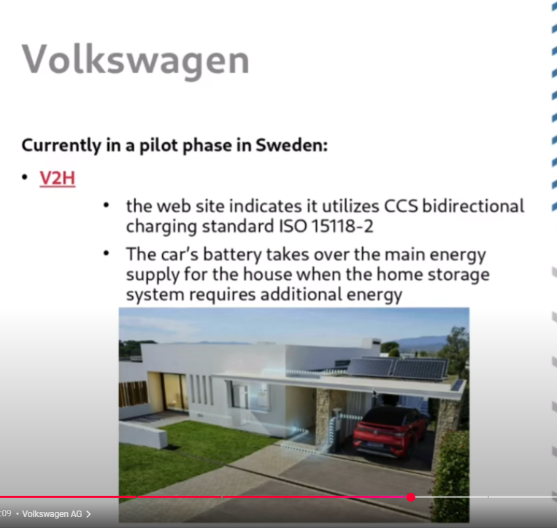
Source:
www.youtube.com
QYRgfLgKOW8
“Electric Vehicles as
Home Backup Power”
Oct, 2024
Hosted by Walter on
“The Network
Architect Channel”
Notes:
Source: www.youtube.com QYRgfLgKOW8 “Electric Vehicles as Home Backup Power” Oct, 2024
Hosted by Walter on “The Network Architect Channel”

Slide 5
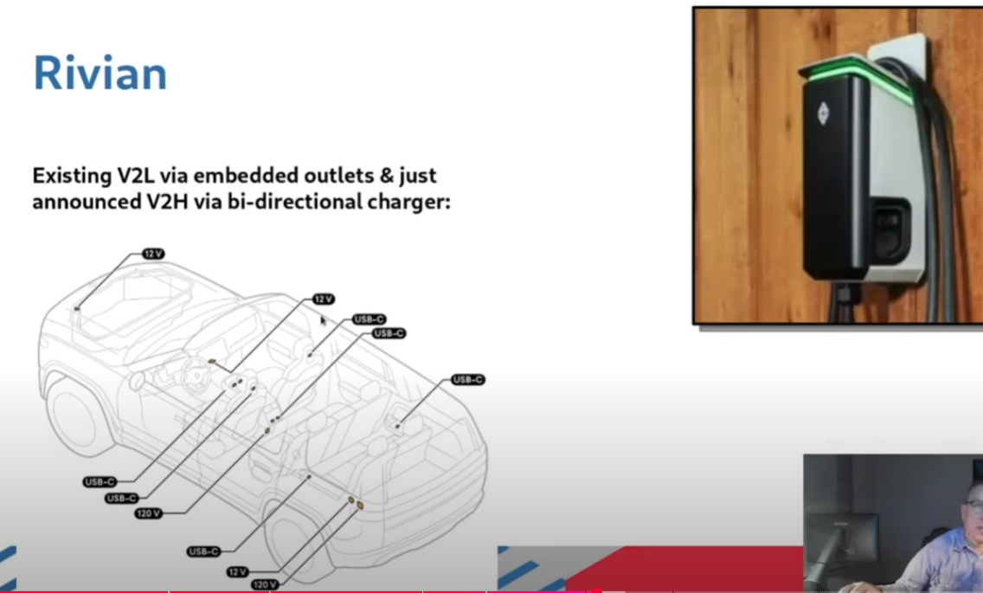
Source:
www.youtube.com
QYRgfLgKOW8
“Electric Vehicles as
Home Backup Power”
Oct, 2024
Hosted by Walter on
“The Network
Architect Channel”
Notes:
RIVIAN has NUMEROUS OUTLETS- most are USB. There are 3 12v outlets, and ONE 120 volt outlet-= and now has has a bi-directional charger to power your house.
Source: www.youtube.com QYRgfLgKOW8 “Electric Vehicles as Home Backup Power” Oct, 2024
Hosted by Walter on “The Network Architect Channel”

Slide 6
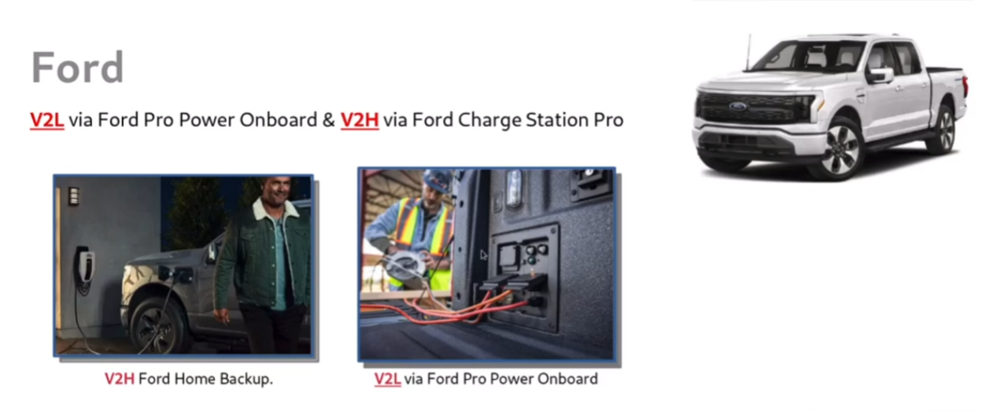
Source:
www.youtube.com
QYRgfLgKOW8
“Electric Vehicles as
Home Backup Power”
Oct, 2024
Hosted by Walter on
“The Network
Architect Channel”
Notes:
PHOTO ON RIGHT: The Ford Lightning has options to plug extension cords, for high power outdoor work.
Phhoto on LEFT shows V2House- plugin andpower the house

Slide 7
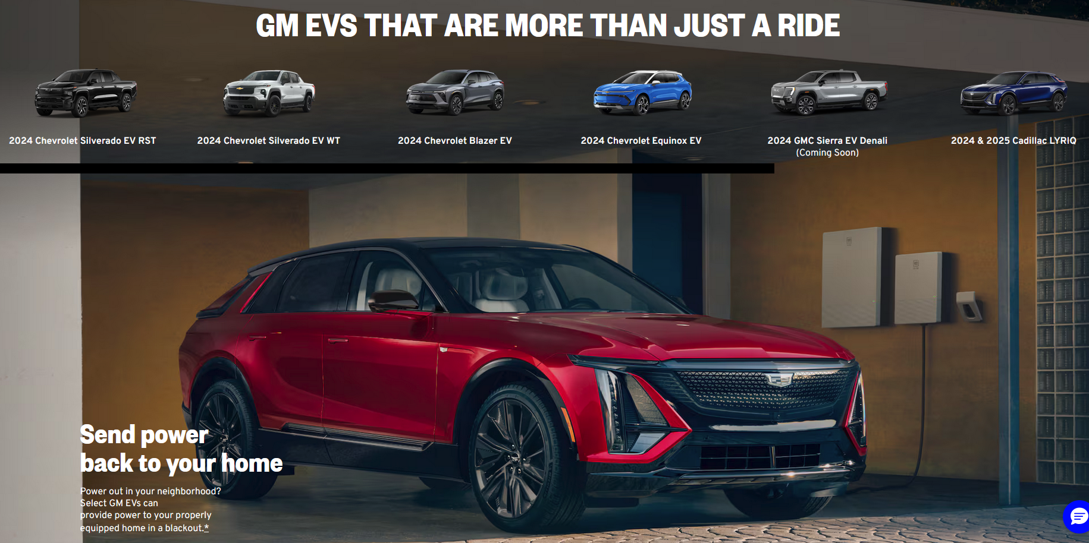
EV AS HOME STORAGE BATTERY
https://gmenergy.gm.com/for-home/products/vehicle-to-home-solutions#unlock
Notes:
READ THE HEADLINES: GM EVs THAT ARE MORE THAN JUST A RIDE
SEND POWER BACK TO YOUR HOME.
POWER OUT IN YOUR NEIGHBORHOOD- GM CAN PROVIDE POWER TO YOUR PROPERLY EQUIPPED HOME IN A BLACKOUT.
Begiinnin with the 2026 models (out now) all 7 EV car brands, under the GM umbrella, will have compatible interfaces to the Proprietary signallingg used between the car and the bi-directional charger.
Currently models that will include v2h are the 2024 Chevrolet Silverado EV RST, the 2024 GMC Sierra EV Denali Edition 1, 2024 Chevrolet Blazer EV, 2024 Chevrolet Equinox EV, 2024 Cadillac Lyriq, and the 2025 Cadillac Escalade IQ.
GM has 7 brands with EVs. All compatible SW with the same bi-directional charger
FOOORD and TESLA each have proprietary interfaes to bi-directional charger

Slide 8
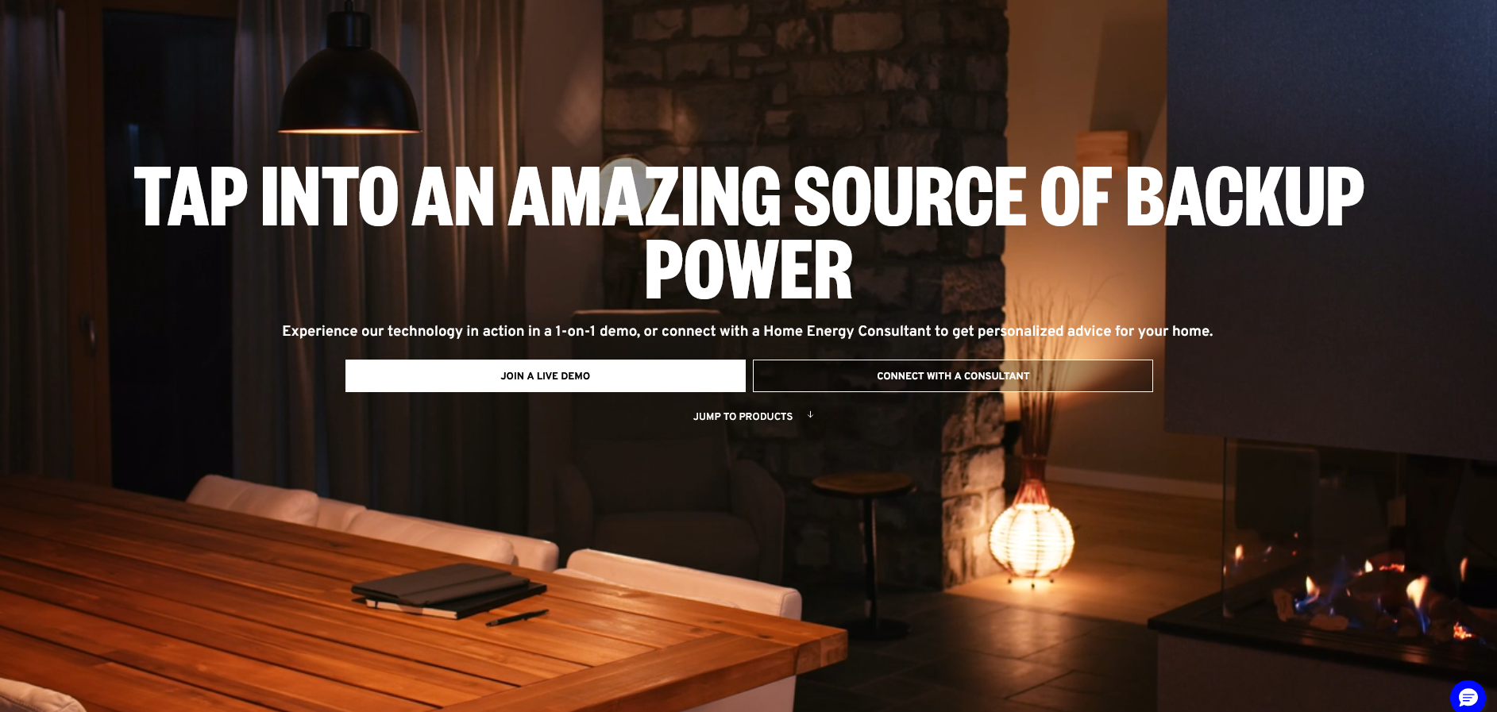
https://gmenergy.gm.com/for-home/products/vehicle-to-home-solutions#unlock
Notes:
GM SAYS: TAP INTO AN AMAZING SOURCE OF BACKUP POWER
I used this site for animations, and personal conversations with 2 agents who supplied more info

Slide 9
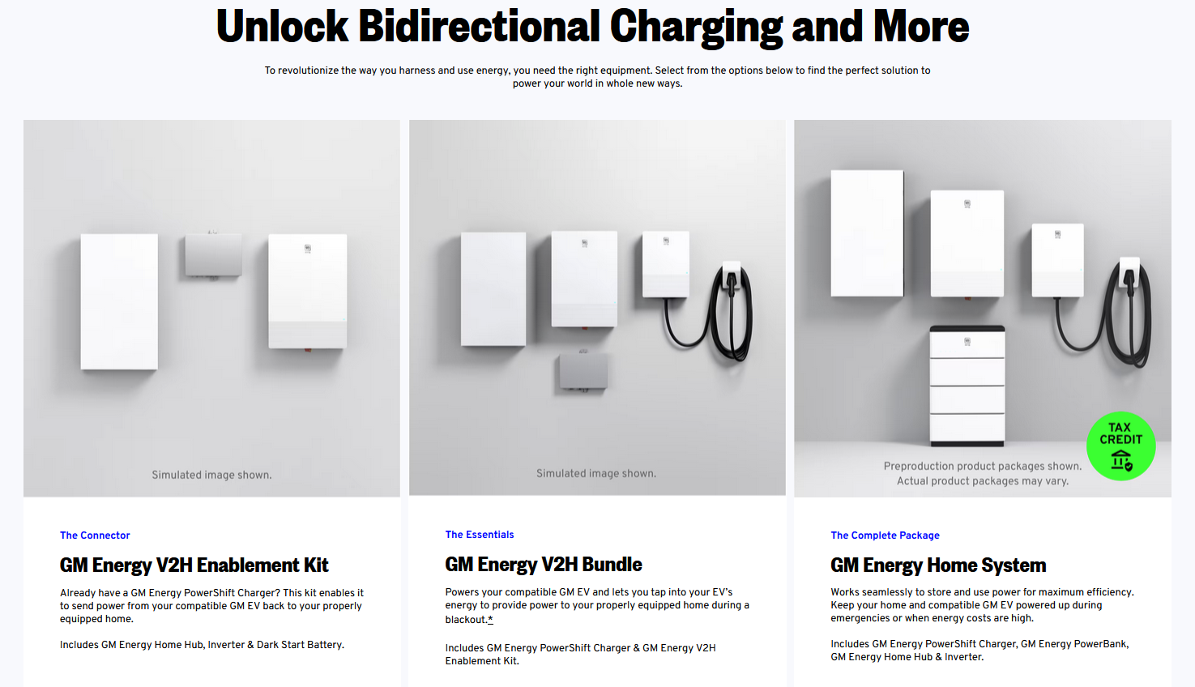
GM VEHICLE TO HOME (V2H)
Dark Start
Battery
Bi-Directional
Charger 19KW
(80Amp@240V)
Disconnects
the Grid
Powers these devices
When grid is down
Starting
At $7300
Energy
Home Hub
Inverter
Switches
Pre-Designated
Parts of Home to
Backup Battery
Switches
DC (battery)
To AC
To operate
appliances
$5600
plus
$1700
$5600
GM Energy PowerBank
Home Wiring $7K to 13K (via “QMERIT”)
https://gmenergy.gm.com/for-home/products/vehicle-to-home-solutions#unlock + interactive sales agents
Notes:
START ON THE RIGHT: GM OFFERS A WALL BATTERY – GM ENERGY POWERBANK. THE $7300 PRICE SEEMS VERY REASONABLE- OF COURSE, THIS IS INDEPENDENT OF VEHICLE TO HOUSE ELECTRICITY
THEN LOOK AT THE MIDDLE PICTURE – TO POWER YOUR NEW EV , YOU BUY A GM BRANDED BI-DIRECTIONAL CHARGER FOR $1700 – VERY POWERFUL 80 AMPS.
IF YOU HAVE A SMALL 100 AMP PANEL, YOU COULD POWER THE WHOLE HOUSE-
NOW LOOK A THE LEFT PHOTO: YOU NEED 2 MAJOR BOXES FOR THE EV TO POWER THE HOUSE
INVERTER – IS LIKE THE INVERTER YOU NEED FOR SOLAR – dc FROM THE EV TO AC NEEDED BY THE HOUSE)
ON FAR LEFT “ENERGY HOME HUB”. THIS IS THE TRANSFER SWTICH, REQUIRED WHEN THE GRID IS DOWN, TO ISOLATE THE HOUSE FROM THE GRID.
THIS “HOME HUB” REQUIRES AN ELECTRIICAN TO SELECT AND WIRE THE MOST ESSENTIAL PARTS OF YOUR HOUSE WHEN THE GRID FAILS.
The SMALLISH “dark start battery” detects the power outage and begins to give initial power to the rest of these systems, EQUIPMENT COSTS FOR JUST V2H: $7300.
LABOR TO INSTALL STARTS AT $7K-UP TO $13K – MORE THAN THE PRICE OF ALL THE SYSTEM COMPONENTS

Slide 10
BALTIMORE GAS & ELECTRIC VEHICLE to GRID
(trial with SunRun Solar/Batteries)
https://www.canarymedia.com/articles/electric-vehicles/did-ford-just-shake-up-the-home-backup-power-market (2021 offer)
  90kwh (30kwh each day =90kwh total from Ford Lightning Vehicle to House. Requires $9K two-way charger + “home management system” (transfer switch)
https://www.canarymedia.com/articles/ev-charging/in-a-first-electric-ford-f-150-trucks-are-powering-homes-in-baltimore
2024 trial: Currently, only vehicle to house is allowed
Maryland just passed “Drive Act” https://mgaleg.maryland.gov/2024RS/fnotes/bil_0006/hb1256.pdf
CREATES OPPORTUNITY FOR UTILITY SMART CHARGING TO GRID
(BGE plans VEHICLE TO GRID by July, 2025)
Notes:
THIS IS WHERE THE INDUSTRY IS GOING – THE MARYLAND “DRIVE ACT” ADDS VEHICLE TO POWER THE GRID. (ON DEMAND WHEN THE GRID NEEDS IT
THERE WILL BE AN INITIAL TRIAL BY BALTIMORE GAS & ELECTRIC THIS SUMMER
SO WE HAVE V2L
V2LOAD
V2HOUR
AND IN THE FUTURE
V2GRID
ALL MY REFERENCE ARE LINKED ON THIS SLIDE, AT NEXT SLIDE
THIS WHOLE PRESNETAITON WILL BE ON-LINE IN A DAY OR TWO
ANY QUESTIONS??
Mike has been checking with his BPU friends.
MIKE – can you offer words of wisdom??

Slide 11
REFERENCES
EV - HOME STORAGE
Overview article: https://www.canarymedia.com/articles/ev-charging/how-to-pick-the-best-electric-vehicle-charger-for-you
https://gmenergy.gm.com/for-home/products/vehicle-to-home-solutions
https://www.canarymedia.com/articles/ev-charging/in-a-first-electric-ford-f-150-trucks-are-powering-homes-in-baltimore
Maryland passed “Drive Act” https://mgaleg.maryland.gov/2024RS/fnotes/bil_0006/hb1256.pdf
https://www.youtube.com/watch?v=QYRgfLgKOW8 (Oct, 2024)

